Slide 1
Math 642: Introduction to Machine Learning Spring 2020 Lecture 6: Classification and Logistic Regression
Some of the figures in this presentation are taken from "An Introduction to Statistical Learning, with applications in R" (Springer, 2013) with permission from the authors: G. James, D. Witten, T. Hastie and R. Tibshirani

Slide 2
Class Schedule
Lec | Date | Lecture | Due
1 | Jan 15 | Intro, Linear Regression, Bias and Variability
2 | Jan 22 | Unsupervised Learning: Clustering, Principle Comp. Analysis | Hwk 1
3 | Jan 29 | KNN Regression, Cross Validation, Bootstrap | Hwk 2
4 | Feb 5 | Ridge Regression, LASSO, Principle Components Regression | Hwk 3
5 | Feb 12 | Extreme Nonlinear: Step Functions, Splines, Gradient Descent | Hwk 4, Project Plan
6 | Feb 19 | Classification, Logistic Regression | Hwk 5
7 | Feb 26 | Discriminant Analysis, Support Vector Machines | Hwk 6, Plan Revision
 | Mar 4 | Mid Term Exam
 | Mar 11 | Spring Break
8 | Mar 18 | Tree-Based Methods | Hwk 7
9 | Mar 25 | Neural Networks, Deep Learning | Hwk 8
10 | Apr 1 | Convolutional Neural Networks | Hwk 9
11 | Apr 8 | Bayesian Analysis, Project Presentations | Final Project Due
12 | Apr 15 | Time Series, Project Presentations | Hwk 10
13 | Apr 22 | Ethics of Machine Learning, Project Presentations | Hwk 11
 | Apr 29 | Study Day
 | May 6 | Final Exam

Slide 3
Machine Learning Taxonomy
Statistical Learning
Outcomes
No Outcomes
Supervised
Unsupervised
Quantitative
Estimation
Outcome
is a Number
Outcome
is a Class
Classification
Clustering
Principal
Components
Logistic Regression
Parametric
Estimation
Non-Parametric
Estimation
Bayesian Belief Network
LDA/QDA
y = f(x)
non-equation
based
KNN Classification
Linear Regression
Common Elements
Cross Validation
Feature Selection
Gradient Descent
Bootstrap
Boosting
KNN Regression
SVM
Ridge Regression
Clustering
Decision Trees
LASSO
Decision Trees
Neural Nets
Splines
Time Series
Bayesian Modeling
Bayesian Modeling

Slide 4
REVIEW

Slide 5
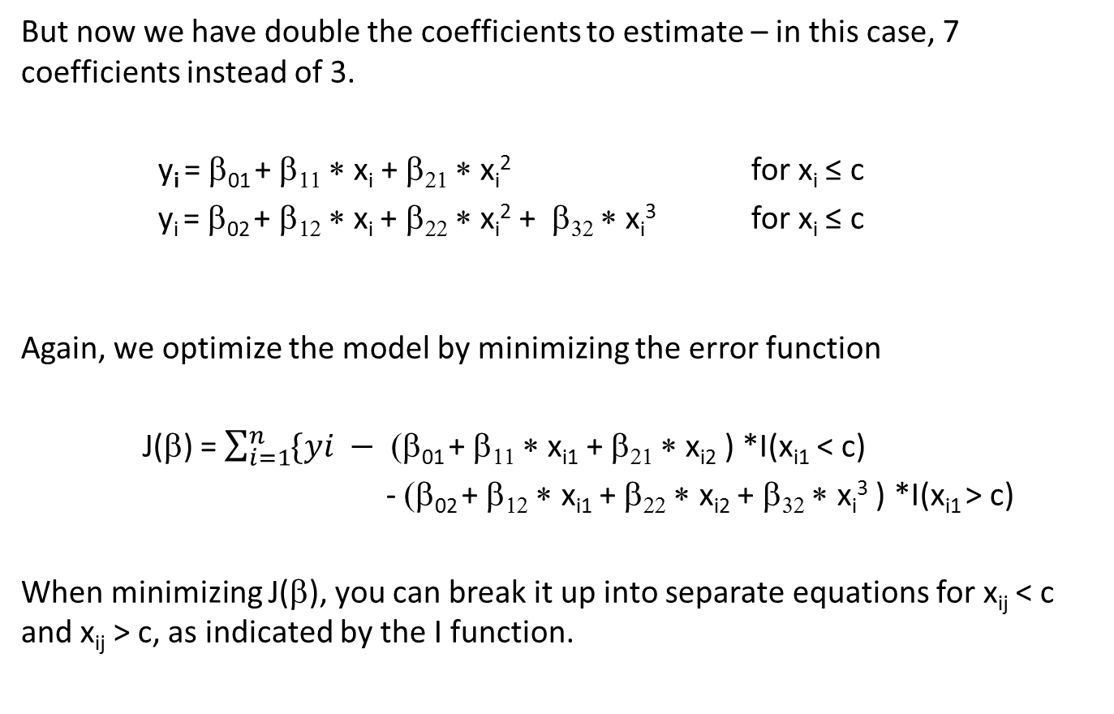
Piecewise Polynomial Models
But now we have double the coefficients to estimate – in this case, 7 coefficients instead of 3.
y_{i} = β₀₁ + β₁₁ ∗ x_{i} + β₂₁ ∗ x_{i}² for x_{i} ≤ c
y_{i} = β₀₂ + β₁₂ ∗ x_{i} + β₂₂ ∗ x_{i}² + β₃₂ ∗ x_{i}³ for x_{i} ≤ c
Again, we optimize the model by minimizing the error function
J(β) = $\sum_{i=1}^{n}{\{yi − }$ (β₀₁ + β₁₁ ∗ x_{i1} + β₂₁ ∗ x_{i2} ) *I(x_{i1} < c)
- (β₀₂ + β₁₂ ∗ x_{i1} + β₂₂ ∗ x_{i2} + β₃₂ ∗ x_{i}³ ) *I(x_{i1} > c)
When minimizing J(β), you can break it up into separate equations for x_{ij} < c and x_{ij} > c, as indicated by the I function.
^
^
^
^
^
^
^
^
^
^
^
^
^
^

Slide 6
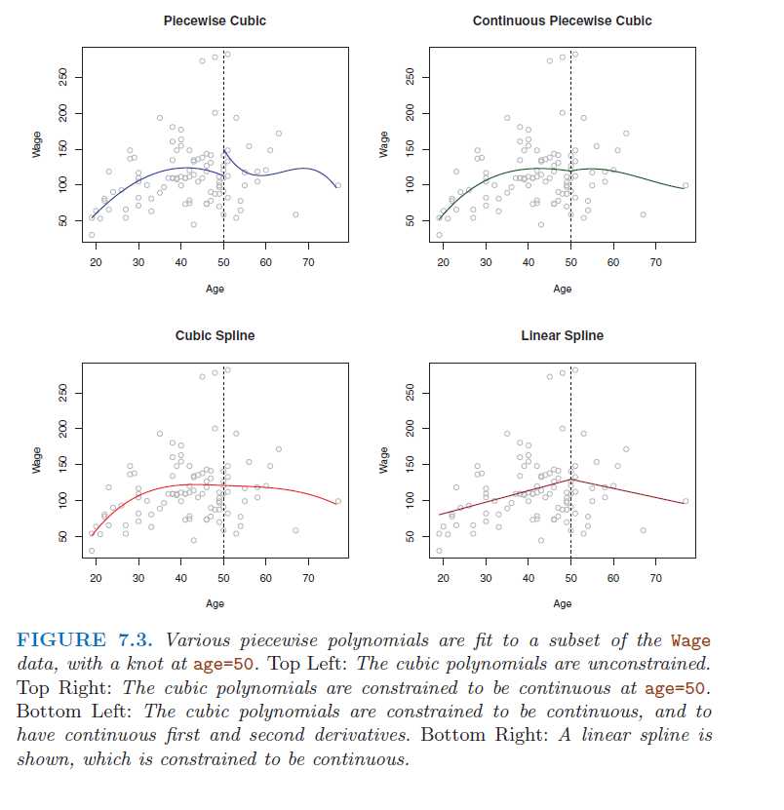
Examples of Discontinuities

Slide 7
Cubic Spline
A cubic spline with no knots is just a cubic polynomial
Two Cubic polynomials with a knot at c would be
(page 271)
A cubic spline with a knot are 2 separate 3rd order polynomials that fit together smoothly
y_{i} = (β₀₁x_{i} + β₁₁x_{i} + β₂₁x_{i}² + β₃₁x_{i}³ )*I(x < c) +
(β₀₂x_{i} + β₁₂x_{i} + β₂₂x_{i}² + β₃₂x_{i}³ )*I(x > c) + β₄(x − x_{c})³* I(x > c)
(Eqs. 7.9,7.10)

Slide 8
Degrees of Freedom for Cubic Spline
The degrees of freedom (DOF) for a model is equal to the number of coefficients you have that are free to vary in order to minimize the error minus the number of constraints.
For a linear model with 1 knot, there are 2 lines and 4 DOF
If the lines are forced to be continuous at the knot then the DOF = 3
For a cubic polynomial model with 1 knot, DOF = 8
For a cubic spline with 1 knot that is constrained to be
Continuous value, DOF = 7
Continuous value and continuous first derivative (slope), DOF = 6
Continuous value, first derivative, second derivative, DOF = 5

Slide 9
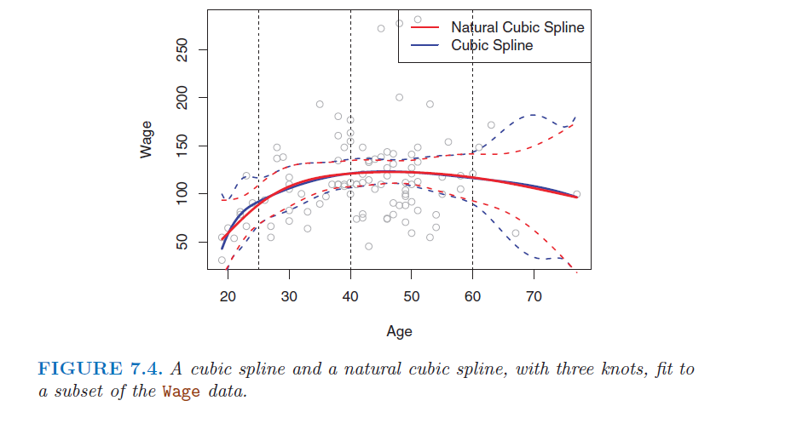
Natural Cubic Splines
Sometimes the cubic spline has low confidence on the edges, and the estimate goes unstable. Natural cubic splines have an added constraint that the function must be linear at the edge of the range.

Slide 10
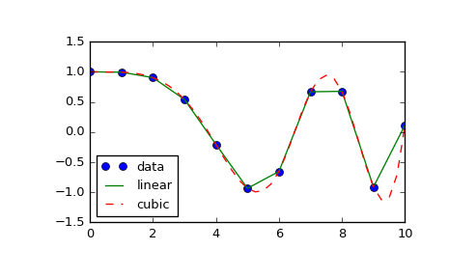
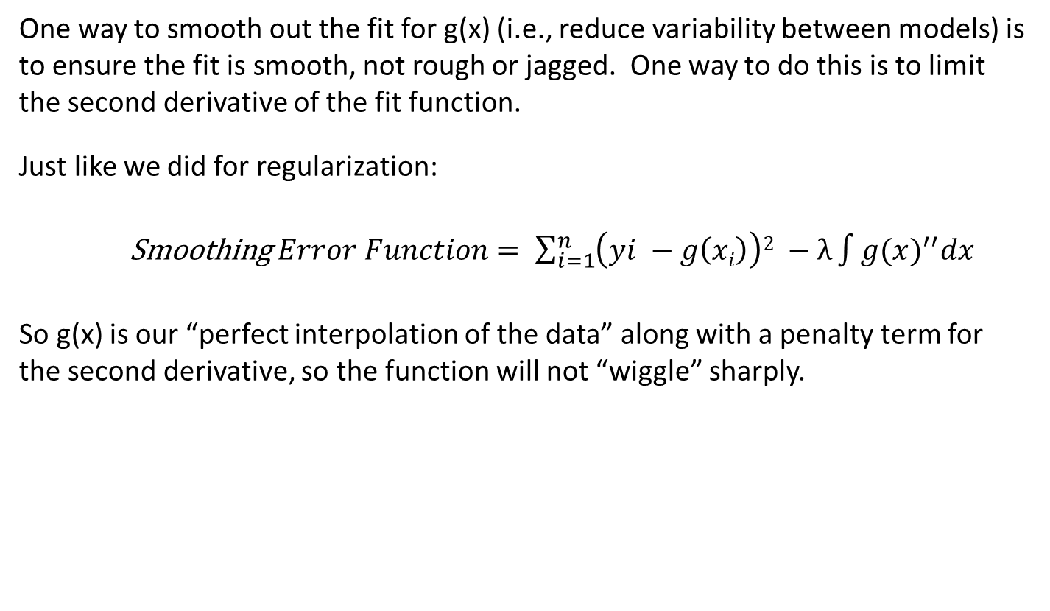
Smoothing Splines
One way to smooth out the fit for g(x) (i.e., reduce variability between models) is to ensure the fit is smooth, not rough or jagged. One way to do this is to limit the second derivative of the fit function.
Just like we did for regularization:
Smoothing $Error Function= \sum_{i=1}^{n}{\left(yi −g\left(xi\right)\right)2 −λ\int{{g(x)}^{′′}dx}}$
So g(x) is our “perfect interpolation of the data” along with a penalty term for the second derivative, so the function will not “wiggle” sharply.
^
^

Slide 11
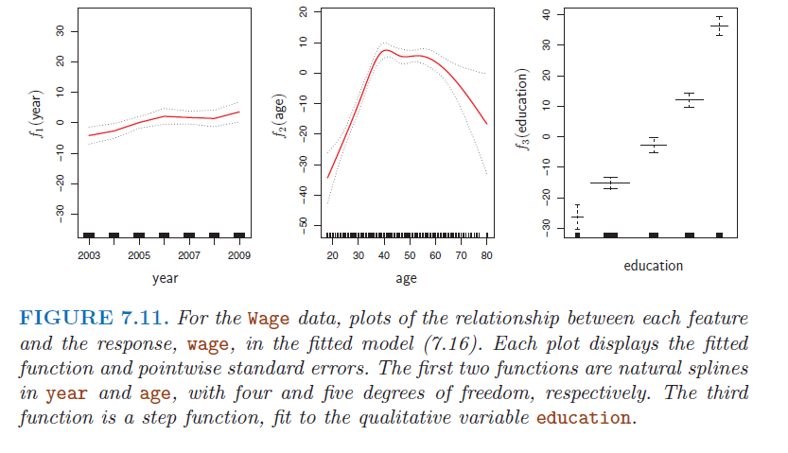
Generalized Additive Models
Natural Splines (year and age) can be viewed as a sum of squares regression onto the spline basis vectors. Thus they can be combined in a regression matrix.

Slide 12
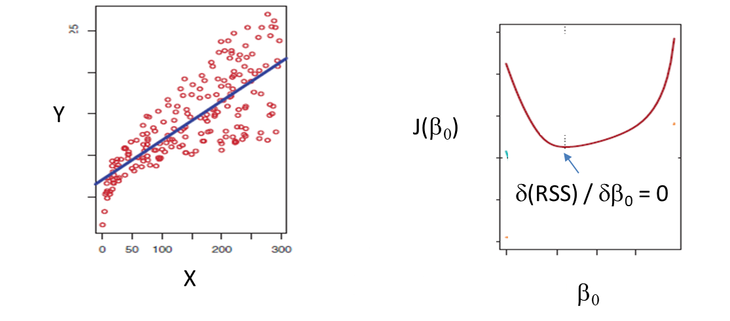
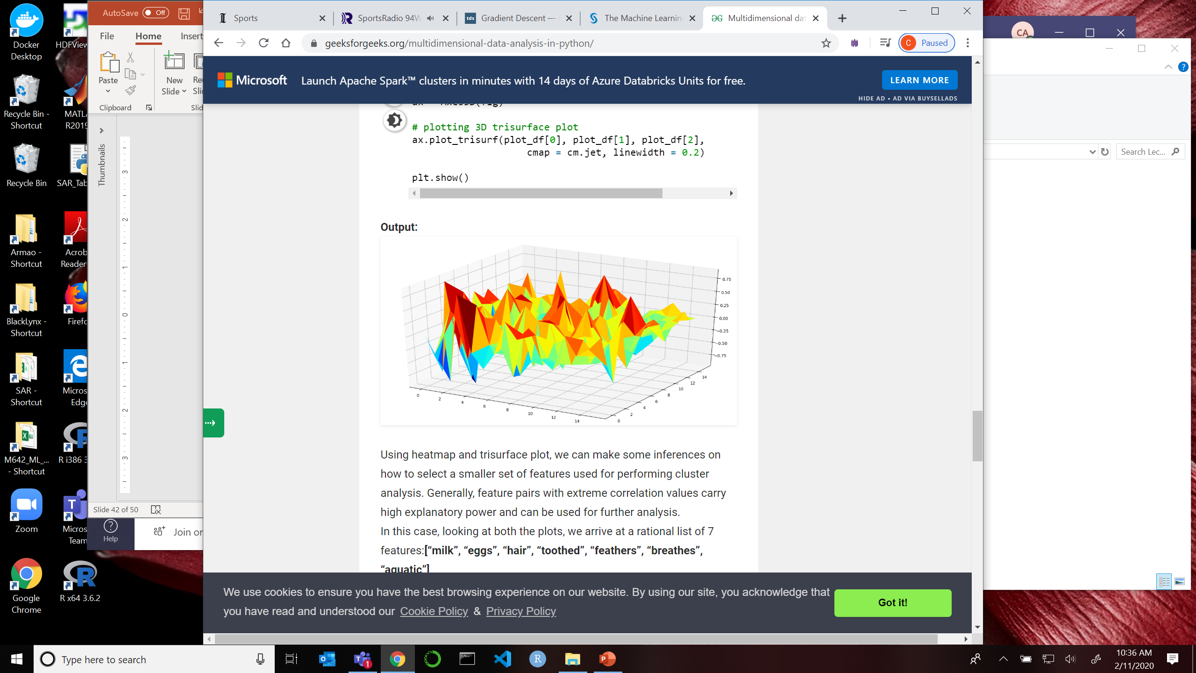
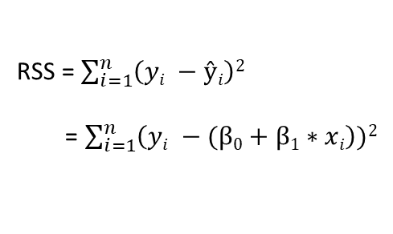
Gradient Descent: Finding the Right Modeling Parameters
Ideally you can compute the right coefficients for your model by calculating the minimum of the Error Function (that is, deterministically)
Sometimes the Error Function cannot be expressed in an equation
Spline Models with discontinuities
Smoothing Spline Models
KNN Models
Models with many (> 1000) features
So how do you find the right coefficients?
RSS = $\sum_{i=1}^{n}{\left(yi −ŷi\right)2}$
= $\sum_{i=1}^{n}{\left(yi −(β0+β1∗xi\right))2}$
RSS(β_{j})
β₂
β₁

Slide 13
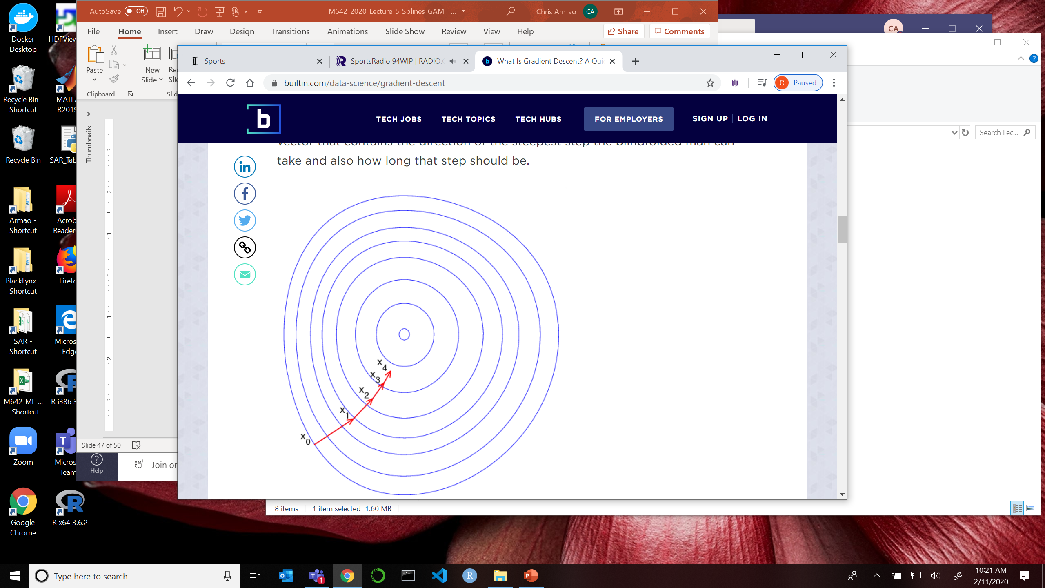
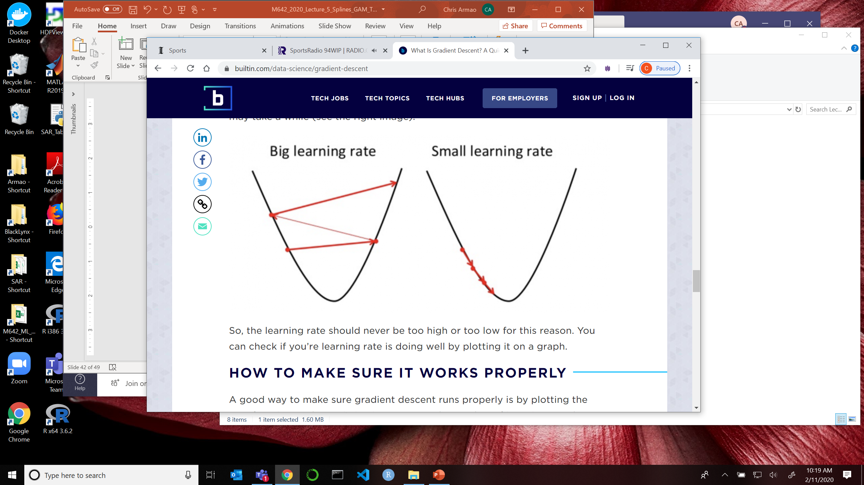
Learning Rate
We need a variable learning rate, γ, to make sure the algorithm is stable. It’s difficult to create an algorithm that works quickly but is stable under all conditions.
β_{new} = β_{old} + γ ∗ Δ ∗ (δJ / δβ)
Where Δ = step size
γ = learning parameter

Slide 14
Classification

Slide 15
ISLR Roadmap
KNN Classification – Section 2.3
Bayes Classifier – Section 2.3
Logistic Regression – Chapter 4

Slide 16
Classification
We’re moving out of one major area of statistical learning – estimating quantitative outcomes – and into a new area called Classification.
Classification: Putting an observation into a category (the outcome variables are often called qualitative or categorical).
Examples of classification problems:
What is this person’s likelihod of surviving cancer for 12 months?
What type of travel advertisement should I show to this person?
Is this credit card applicant likely to default?
Is this text likely to reveal sensitive or protected information if made public?

Slide 17
Classification
I have a set of outcomes that are categorical. These outcomes are discrete, they are not continuous values.
True or False – Patient will survive for 12 months
Highest probability – Web browser is most likely to click on ad for ski resort
Low rate, high rate, no credit – Likelihood that applicant will pay credit card
Releasable or likely to cause conflicts - This text has HIPPA protected information
This picture of an animal is a dog, cat, or horse

Slide 18
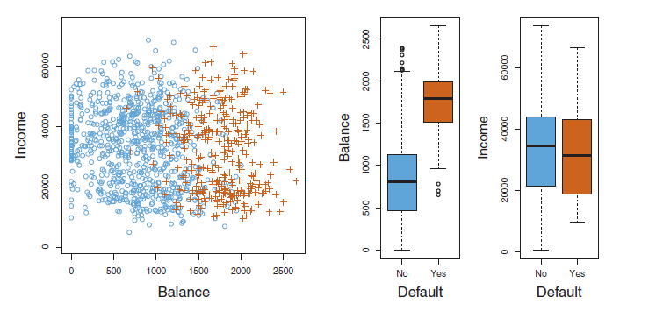
Example: Credit Card Default
Note the features can be quantitative. It’s the outcomes that are binary.

Slide 19
Methods of Classification
Logistical Regression – much like regression, it is the basis for many different techniques, and a standard for comparison between 2 outcomes
Linear and Quadratic Discriminant Analysis – parametric classifiers for multiple outcomes
K Nearest Neighbors – non-parametric technique that is intuitive
Trees / Random Forest – non-parametric and versatile
Support Vector Machines – high margin classifiers
Bayesian Classifiers – uses prior information, low occurrence events
Neural Networks – powerful for complex models with many features that defy human interpretation, requires a large structured sample set

Slide 20
Classification with KNN
K Nearest Neighbors is a simple and intuitive method that works just as well for classification. The predicted class is the most common class in a group of k samples.
x
Prediction for x with k = 8?
20

Slide 21
Classification with KNN
KNN can be written in the form of a conditional probability.
Here, the outcome Y is the class, j. The feature is X, and the point where you want to make a prediction is x₀. K is the number of neighbors to include and N₀ is the shape that includes them. Pr is the probability.
You select the class with the highest probability. It’s referred to as a “voting” algorithm.
21

Slide 22
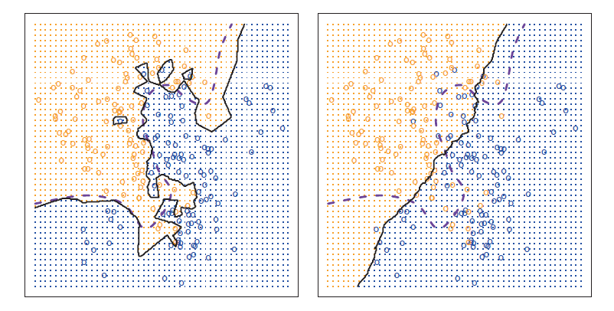
KNN Classifier: How should we set K?
A large K will smooth out the boundary between classes.
This could create bias in the model
Model may not match real data
This could reduce variability in the model
Model probably will not overfit
A small K may generate a very wiggly boundary.
This could reduce bias in the model
Model will follow complicated boundary
This could increase variability in the model
Model may overfit, follow noise

Slide 23
Classification Errors
A classification error means that a sample predicted to be in the same class as y_{i} is not. The average error rate for n samples is
Remember I(y_{i} ≠ y_{i} ) is 0 if y_{i} = y_{i} and 1 otherwise

Slide 24
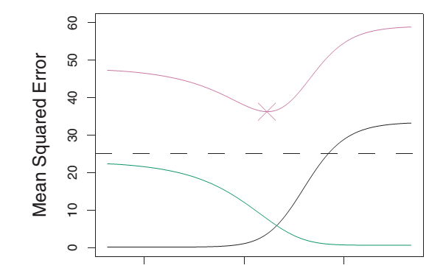
Cross Validation with Classification
Just like for quantitative errors, you have classification errors when you train a model (Training Error), and classification errors when you test the model with new data (Test Error).
Thus CV for a KNN model may look something like
Test Classification Error
Classification Error
Variability
Training Classification Error
30 20 10 1
K
Increasing Flexibility →

Slide 25
Cross Validation with KNN Classifier
The level of K in KNN can give you very different performance, depending in part on the level of random noise in the data. How an you pick the correct K?

Slide 26
Bayes Classifier
As we said, the average classification error is
A Bayes Classifier is a very simple classifier that minimizes the error, Eq 2.8
You pick the class with the highest Pr.
This is a simulated dataset where we know the blue and orange distributions. Bayes is often used as a benchmark for other classifiers. The purple line is where the probability of blue and orange are both 50%.

Slide 27
Bayes Classifier Example
2 classes (green and red) with Gaussian distributions offset by 4. I’m trying to make a prediction at x₀ = 2. What class am I likely to be in?
What about x₀ = 0.1?
_{X}

Slide 28
Example: Credit Card Default
Let’s go back to our credit card classification example.

Slide 29
The Confusion Matrix
We can do Cross Validation for Classification Models
Divide our samples into training samples and test samples
Do k-fold cross validation if necessary
When we run the test samples through our models, we get the following “confusion matrix”
 |  | Actual
 |  | No Default | Default
Predicted | No Default | 9644 | 252
 | Default | 23 | 81

Slide 30
Assessing Classification Models
For our results
True Positive: Prediction was “Default” and actual was “Default” = 81
True Negative: Prediction was “No Default” and actual was “No Default” = 9644
False Positive: Prediction was “Default” and actual was “No Default” = 23
False Negative: Prediction was “No Default” and actual was “Default” = 252
What is the Sensitivity?
What is the Specificity?
What is the False Alarm Rate?
 |  | Actual
 |  | Default | No Default
Predicted | Default | 81 | 23
 | No Default | 252 | 9644

Slide 31
Assessing Classification Models
From our confusion matrix
True Positive Rate = Predicted to be “Default” / Actually were “Default”
= 81 / (252 + 81)
False Positive (False Alarm) Rate = Predicted “Default” / Actually “Not Default”
= 23 / (9644+23) = 1 - Specificity
Sensitivity = Predicted to be “Default” / Actually were “Default”
= 81 / (252 + 81)
= True Positive Rate
Specificity = Predicted “Not Default” / Actually were “Not Default”
= 9644 / (9644 + 23)
= 1 – False Alarm Rate
 |  | Actual
 |  | Default | No Default
Predicted | Default | 81 | 23
 | No Default | 252 | 9644

Slide 32
Confusion Matrix Threshold
This Confusion matrix was made with the PR(threshold) = 50%. Do you have to use 50%?
What if I’m diagnosing skin cancer?
If I miss a detection, that person is likely to die
If I get a false positive, that person will get a follow-up test to confirm.
What if I’m deciding whether of not to get a search warrant for illegal drugs?
If I miss a detection he or she will get caught next time, and my suspects are way bigger than my available officers
If I get a false positive the police department will get sued and I’ll get fired
 |  | Actual
 |  | Default | No Default
Predicted | Default | 81 | 23
 | No Default | 252 | 9644

Slide 33
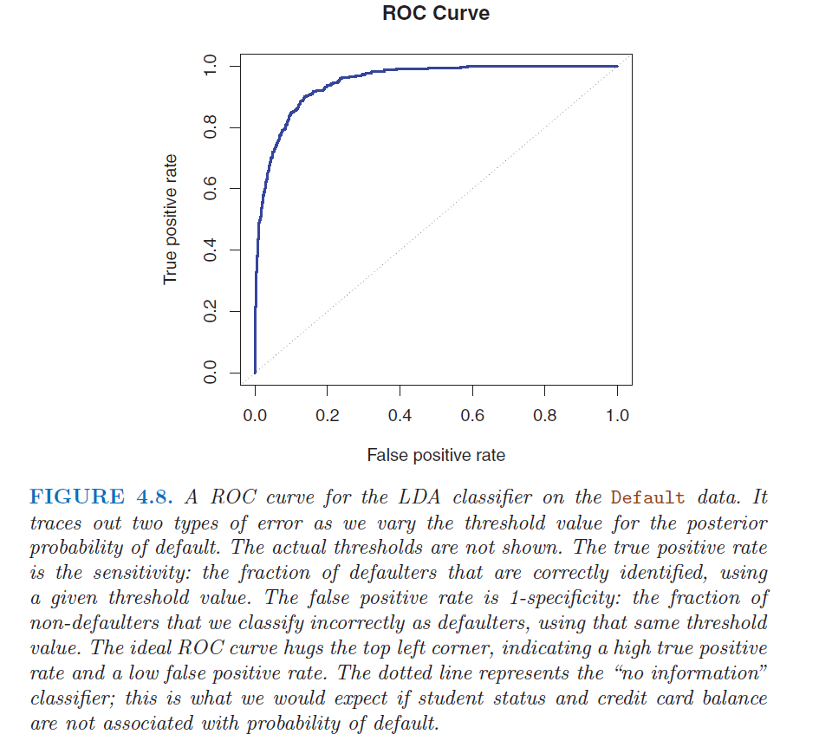
Receiving Operating Characteristic

Slide 34
Receiving Operating Characteristic
x
Skin cancer test
x
Bayes Classifier
x
Drug Bust Warrant

Slide 35
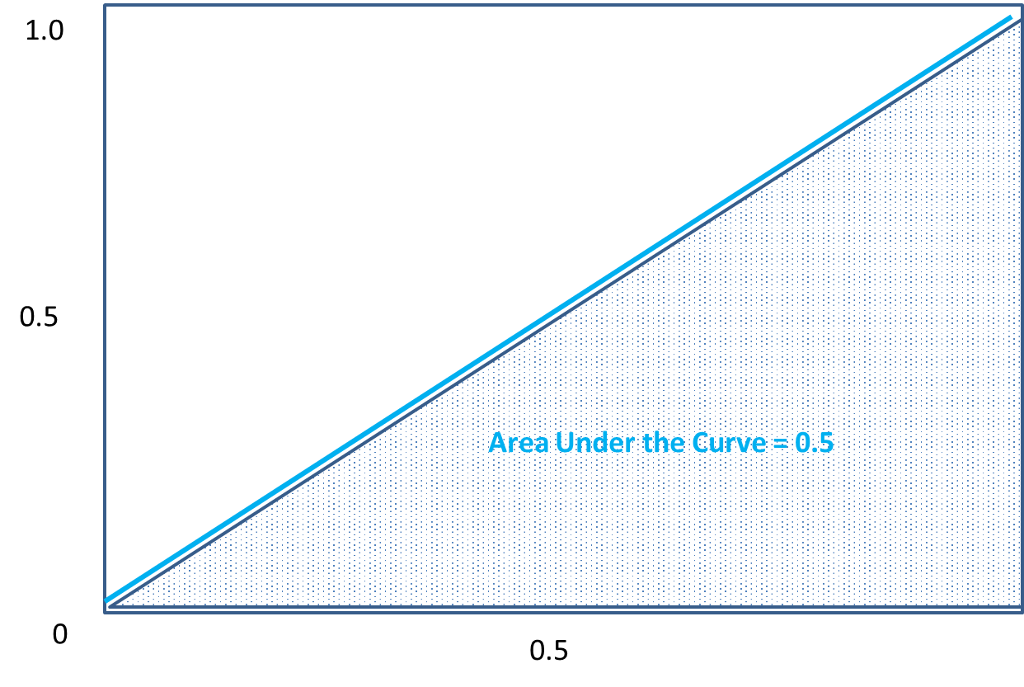
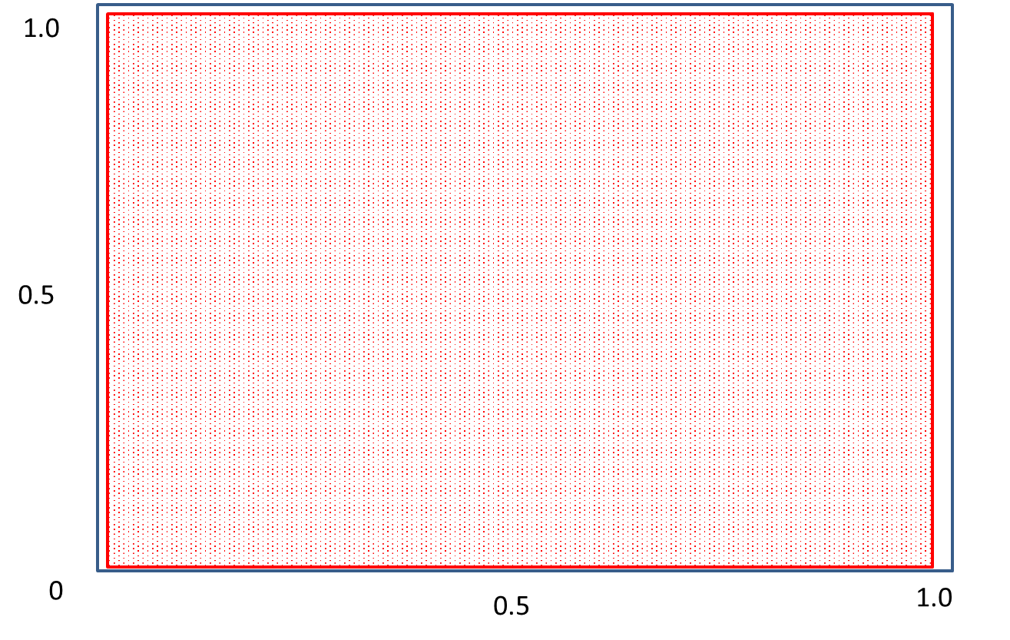
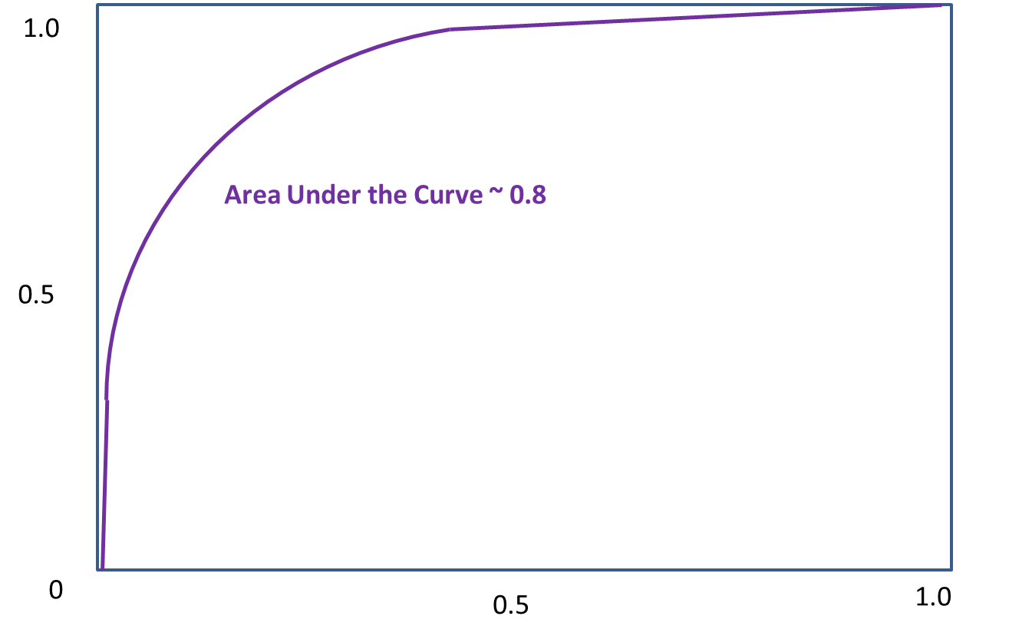
What is good ROC Curve?
Area Under the Curve ~ 0.8

Slide 36
Logistical Regression

Slide 37
Example: Credit Card Default
For credit card default as a function of balance, it’s obvious that
1. A very low balance results in a very low probability of default
as balance → 0 Probability(default) → 0
2. A very high balance results in a high probability of default
as balance → ∞ P(default) → 1.0
There will be some value for balance that will probably represent a “tipping point” and a region where the probability will go from low to high. How rapidly this happens will vary.
How can we represent that mathematically?

Slide 38
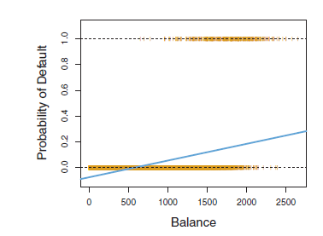
Example: Credit Card Default
The mathematical development behind Logistic Regression:
Could you develop a way to use Least Squares Regression for this problem?
Is this a good linear model?
Is this a good linear model?

Slide 39
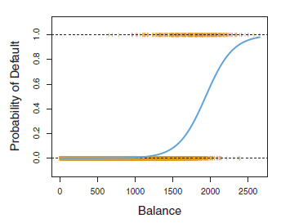
Example: Credit Card Default
It would be better to find a function that has the following characteristics:
Asymptotic to -1 and +1
Adaptable slope to reflect changes in probability

Slide 40
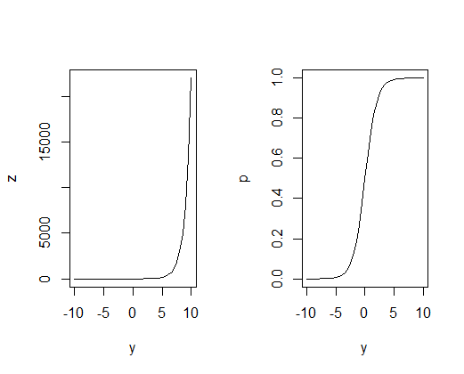
Logistic Function
Let’s construct a function that satisfies our needs
z = e^{y} p = e^{y} / (1 + e^{y})
when y is large, p ~ e^{y}/e^{y} = 1
when y is -large, p ~ 0/1 = 1
when y is 0, p ~ e⁰/(1+e⁰)= 1/2

Slide 41
Logistic Function
How do we map the information in our samples to the logistic function?
There are many ways to do this, and we will take a look at different techniques. But the simplest way to model data is with a linear model:
y_{i} = β₀ + β₁₁x_{i1} + β₁₂x_{i2} …
Then our logistic model becomes
p_{i} = e^{y}i / (1 + e^{y}i)
= e^{(β}0 ^{+ β}11^{xi1 + β}12^{x}i2 ⁾ / (1 + e^{(β}0 ^{+ β}11^{xi1 + β}12^{x}i2 ⁾ )
^
^
^
^

Slide 42
Decision Boundary
How does the Logistic function work?
Let’s say if p(x) < 0.5 we predict 0 and if p(x) ≥ 0.5 we predict 1
Thus when y < 0 we predict 0 and when y > 0 we predict 1
The Decision Boundary is at p = 0.5
^
^
^
^
p
p = 0.5
^
y
^
Predict 0
Predict 1
^

Slide 43
Decision Boundary
^
To find the decision boundary, let’s find the line where y = 0
y = X₁ + X₂ – 4 = 0
thus X₁ + X₂ = 4 is the decision boundary
0
0
4
3
2
1
0
X₂
0
0
1
1
0
0
1
1
0 1 2 3 4
X₁
^

Slide 44
Decision Boundary
What about this Decision Boundary?
y = (X₁)²+ (X₂)² – 1 = 0
thus (X₁)²+ (X₂)² = 1 is the decision boundary
So as you can see y can get complicated and can be linear, smooth, or irregular.
2
1
0
-1
-2
1
1
X₂
1
0
1
0
0
0
1
1
1
1
-2 -1 0 1 2
X₁
^
^

Slide 45
Decision Boundary
A Decision Boundary can suffer from being too simple (too much bias in the fit to the data) or too flexible (model fits the noise)

Slide 46
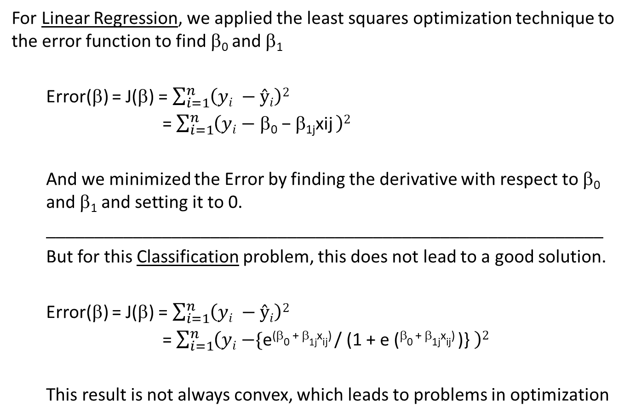
Solving for β₀ and β₁
For Linear Regression, we applied the least squares optimization technique to the error function to find β₀ and β₁
Error(β) = J(β) = $\sum_{i=1}^{n}{\left(yi −ŷi\right)2}$
= $\sum_{i=1}^{n}{\left(yi \text{− }\text{b}\text{0} \text{−} \text{b}\text{1}\text{jxij} \right)2}$
And we minimized the Error by finding the derivative with respect to β₀ and β₁ and setting it to 0.
__________________________________________________________
But for this Classification problem, this does not lead to a good solution.
Error(β) = J(β) = $\sum_{i=1}^{n}{\left(yi −ŷi\right)2}$
= $\sum_{i=1}^{n}{\left(yi \text{−}\text{\{}\text{e}\text{(}\text{b}\text{0}\text{ + }\text{b}\text{1}\text{j}\text{x}\text{ij}\text{) }\text{/ (1 + }\text{e}\text{ (}\text{b}\text{0}\text{ + }\text{b}\text{1}\text{j}\text{x}\text{ij}\text{) }\text{)}\text{\}} \right)2}$
This result is not always convex, which leads to problems in optimization
^
^

Slide 47
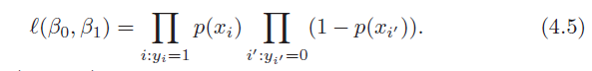
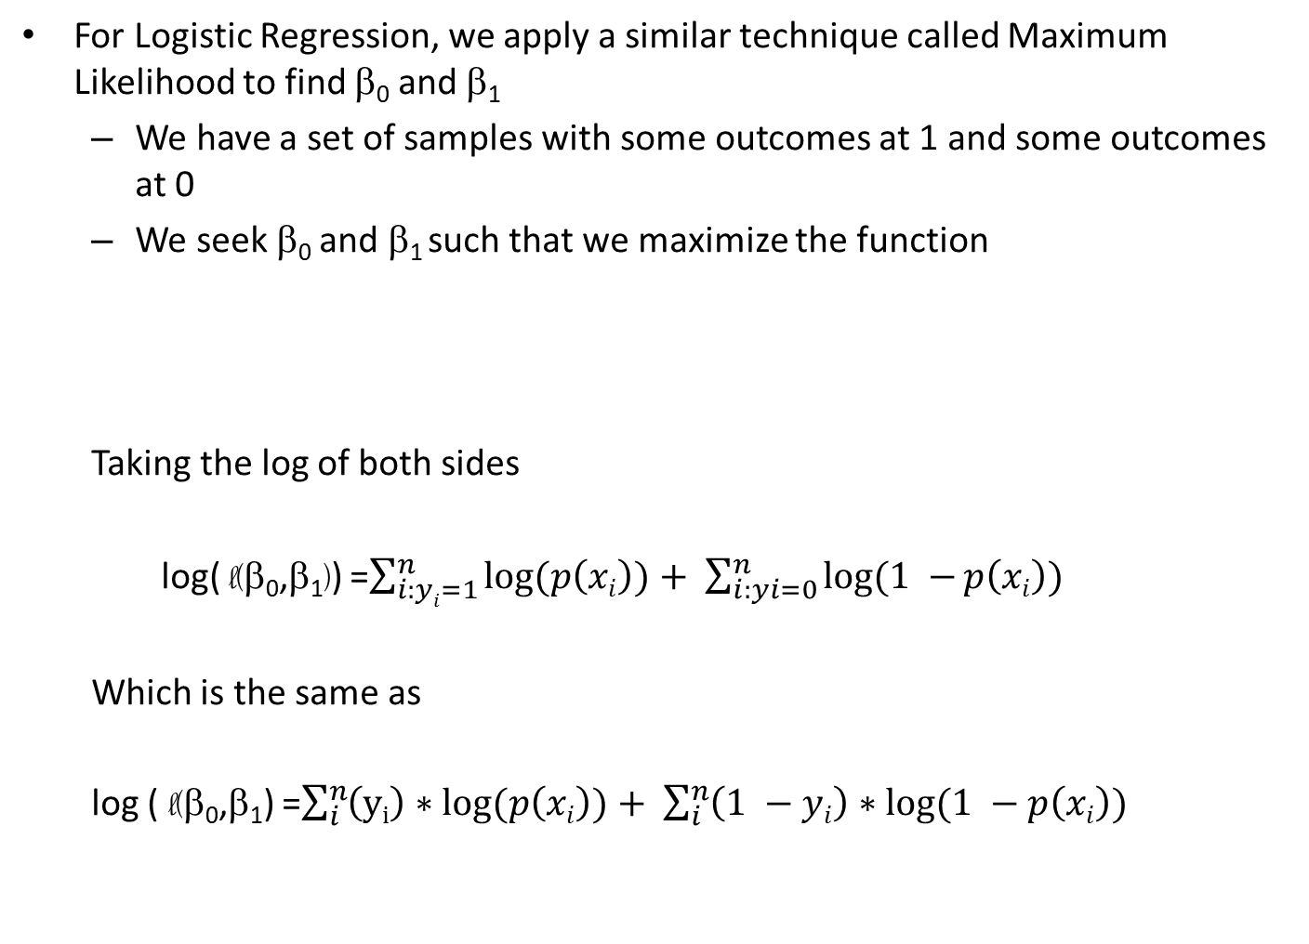
Maximum Likelihood
For Logistic Regression, we apply a similar technique called Maximum Likelihood to find β₀ and β₁
We have a set of samples with some outcomes at 1 and some outcomes at 0
We seek β₀ and β₁ such that we maximize the function
Taking the log of both sides
log( l(β₀,β₁)) =$\sum_{i:yi=1}^{n}{log⁡(p\left(xi\right))+ }$ $\sum_{i:yi=0}^{n}{log⁡(1 −⁡p\left(xi\right)) }$
Which is the same as
log ( l(β₀,β₁) =$\sum_{i}^{n}{\left(yi\right)∗log⁡(p\left(xi\right))+ }$ $\sum_{i}^{n}{\left(1 −yi\right)∗log(1 −p\left(xi\right)) }$

Slide 48
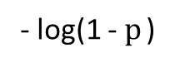
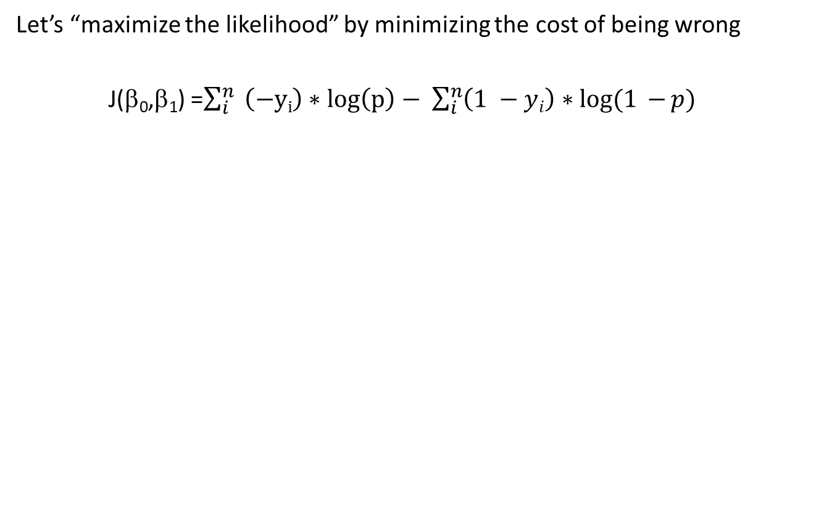
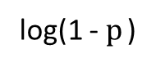
A Better Cost Function
Let’s “maximize the likelihood” by minimizing the cost of being wrong
J(β₀,β₁) =$\sum_{i}^{n}{ \left(−yi\right)∗\log\left(\text{p}\right)− }$ $\sum_{i}^{n}{\left(1 −yi\right)∗log(1 −{p}) }$
y_{i} = 1
y_{i} = 0
- log(p)
Cost
Cost
- log(1 - $p$)
log(p)
p
p
0 1
0 1
log(1 - $p$)

Slide 49
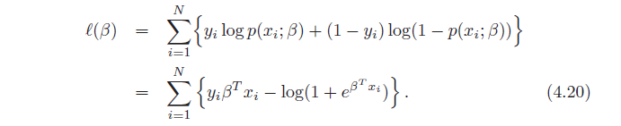
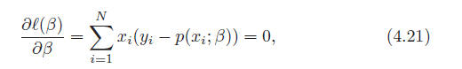
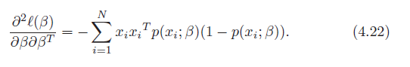
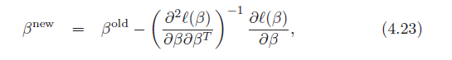
Solving Maximum Likelihood
The following is presented so that you have seen it. It is not required to be studied for this course. From “Elements of Statistical Learning”:

Slide 50
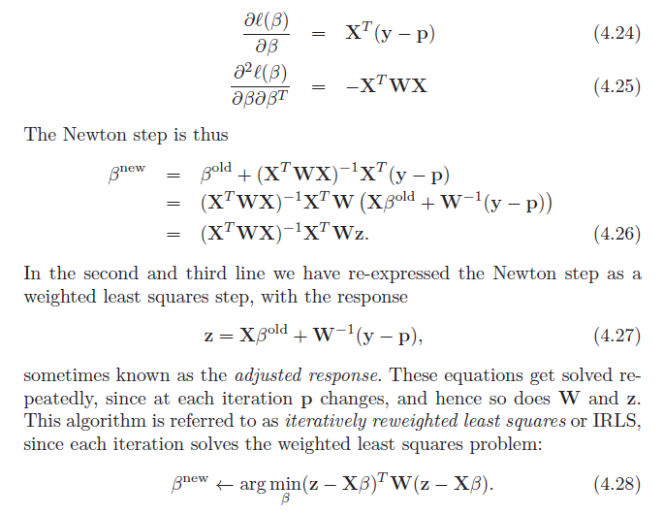
Solving Maximum Likelihood
See “Elements of Statistical Learning”:

Slide 51
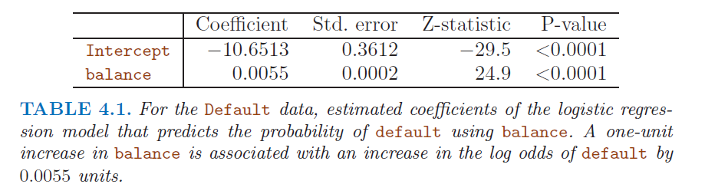
R Output for Logistic Regression
A large z-statistic indicates evidence against the null hypothesis
that β₁ = 0. A small p-value indicates the coefficient is significant.

Slide 52
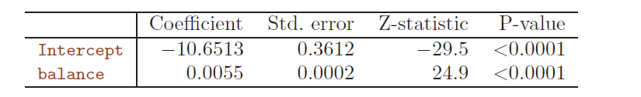
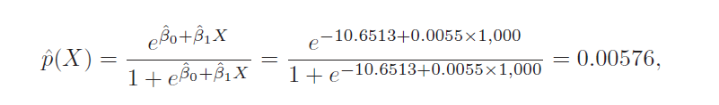
Making a Prediction can be tricky
For a credit card balance of $1000.00, p(default) is:

Slide 53
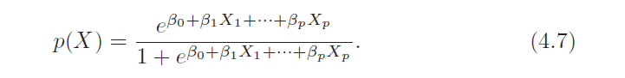
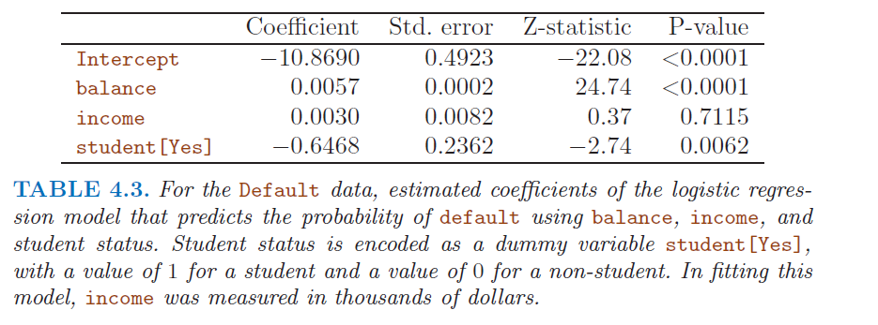
Multiple Logistic Regression

Slide 54
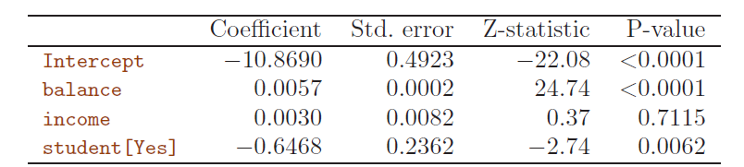
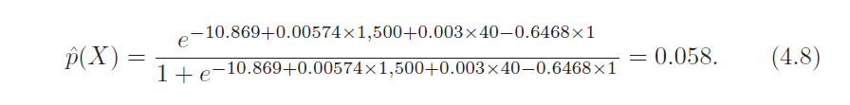
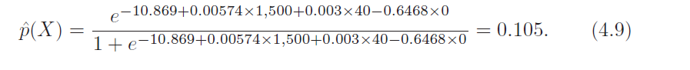
Making Predictions using multiple logistic regression

Slide 55
Odds
If a horse is running a race, and it has a 0.25 probability of winning, what are the odds it will win?
Odds = p / (1-p)
So this horse has a 1 in 3 chance of winning.
What about if the horse has a 0.9 probability of winning?

Slide 56
Odds
If the logistic function represents the probability that the binary is 1 or 0, what does the linear model represent?
If
p_{i} = (e^{β}₀ ^{+ β}_{1j}^{x}_{ij} ) / (1 + e ^{β}₀ ^{+ β}_{1j}^{x}_{ij} )
then
p_{i} / (1 – p_{i}) = e^{β}₀ ^{+ β}_{1j}^{x}_{ij}
Called the “Odds” and
ln{p_{i} / (1 - p_{i})} = β₀ ⁺ β_{1j}x_{ij}
Called the “Log-Odds” or “Logit”

Slide 57
Problems with Logistic Regression
When the distributions are well separated, logistic regression is not sufficiently stable
When n is small and the x’s are normally distributed, logistic regression is not sufficiently stable
Logistic regression does not handle multiple classes well
Question: What is an alternative to Logistic Regression that is more stable and handles multiple (more than 2) classes easily?
Answer: Discrimminant Analysis

Slide 58
BREAK

Slide 59
Bayesian Classification

Slide 60
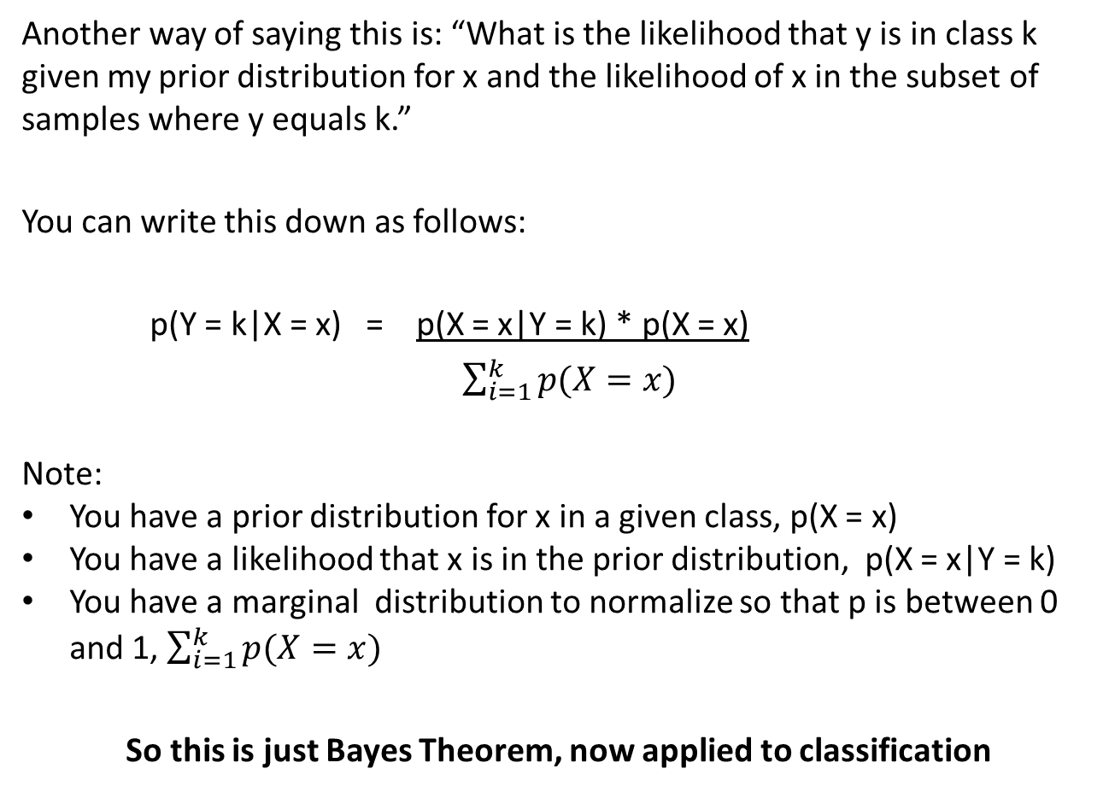
Discrimminant Analysis
Another way of saying this is: “What is the likelihood that y is in class k given my prior distribution for x and the likelihood of x in the subset of samples where y equals k.”
You can write this down as follows:
p(Y = k|X = x) = p(X = x|Y = k) * p(X = x)
$\sum_{i=1}^{k}{p(X=x)}$
Note:
You have a prior distribution for x in a given class, p(X = x)
You have a likelihood that x is in the prior distribution, p(X = x|Y = k)
You have a marginal distribution to normalize so that p is between 0 and 1, $\sum_{i=1}^{k}{p(X=x)}$
So this is just Bayes Theorem, now applied to classification

Slide 61
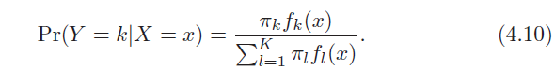
Bayes Theorem for Classification
Notation: Let
π_{k} = probability that a randomly chosen observation belongs to a class k
= the fraction of the sample that is in class k
= prior distribution
and
f_{k}(x) = p(X=x|Y=k)
= the density function (or likelihood) of x in the k^{th} class
Then Bayes’ Theorem becomes
Where Pr(Y=k|X=x) is the probability that a given observation belongs to class k based on the value(s) of x.

Slide 62
Logistic Regression versus Discrimminant Analysis
Logistic Regression:
Model the conditional distribution of the response Y given the predictor(s) X
p(Y = k | X = x)
Discrimminant Analysis:
Model the distribution of X within each class. Then figure out Y based on the distribution of X within each class.

Slide 63
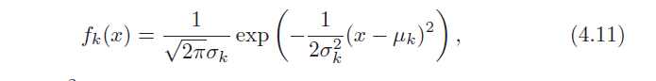
Naïve Bayes Classifier for Gaussian Distribution
We need to make an assumption about f_{k}(x). We’ll assume that f_{k}(x) is a normal (Gaussian) distribution
Then
With μ_{k}= the mean for class k and σ_{k} = the variance for class k.
Further assume σ₁ = σ₂ = … = σ_{k}
(note: μ_{k} can vary from class to class)

Slide 64
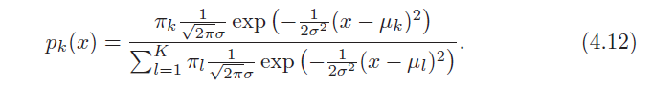

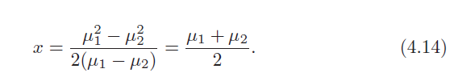
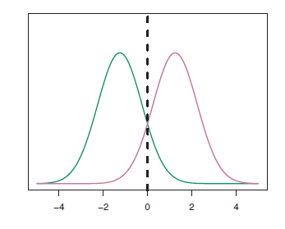
Naïve Bayes Classifier for Gaussian Distribution
With the aforementioned assumptions, the posterior is:
Bayes is the ideal classifier if the prior distribution is normal (or Gaussian) and the likelihood is normal. In this case the Decision Boundary is:

Slide 65
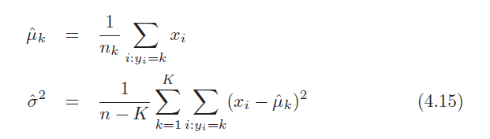
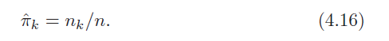
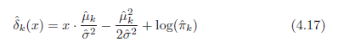
Linear Discrimminant Analysis
The LDA uses the following estimates for the parameters used in the Bayes’ Classifier:
It’s easy to determine π_{k}. Just take some samples and determine the fraction of y that belongs to class k.
If no information is available for π_{k}, LDA assumes
Then the “Linear Discrimminant” function becomes

Slide 66
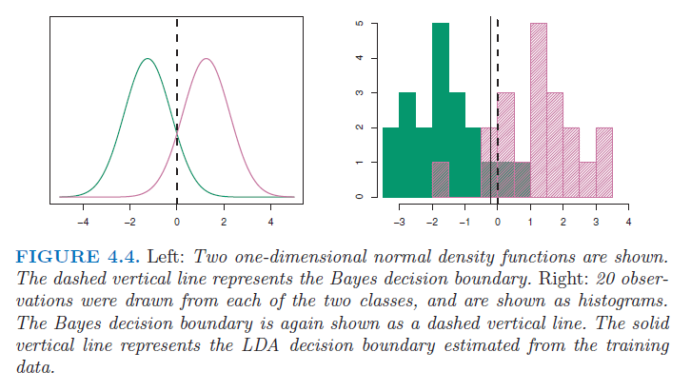
Linear Discrimminant Analysis
With these assumptions, the PDA decision Boundary can be very close to the Bayes decision boundary. Here is an example that shows a comparison between Bays and LDA

Slide 67


Multivariate Case: LDA for p > 1
A Gaussian function for 2 features is like a 3-D normal distribution.

Slide 68

LDA for p > 1
For equation 4.18,
x = $\left[\begin{aligned}x1 \\ x2 \\ . \\ . \\ . \\ xp\end{aligned}\right]$ μ = $\left[\begin{aligned}\text{m}1 \\ \text{m}2 \\ . \\ . \\ . \\ \text{m}p\end{aligned}\right]$
Σ = Cov(X) = $\left[\begin{matrix}E(X1−\text{m}\text{1 })E(X1−\text{m}\text{1}\text{)} & ⋯ & E(X1−\text{m}\text{1 })E(Xp−\text{m}\text{p}\text{)} \\ ⋮ & ⋱ & ⋮ \\ E(Xp−\text{m}\text{p})E(X1−\text{m}\text{1}) & ⋯ & E(Xp−\text{m}\text{p})E(Xp−\text{m}\text{p}\text{)}\end{matrix}\right]$

Slide 69
LDA for p > 1
This is the (p x p) matrix analogy to σ² in 1 dimension.
The diagonals are the familiar variances for that feature, X_{p}.
The off-diagonals show how the features are varying as a pair.
The Covariance Matrix Σ is symmetric Σ_{ij} = Σ_{ji}

Slide 70


LDA for p > 1

Slide 71


Quadratic Discriminant Analysis
Unlike LDA, QDA assumes each Gaussian-distributed class has a distinct covariance matrix. Then Bayes becomes

Slide 72

Quadratic Discriminant Analysis

Slide 73
LDA, QDA versus Bayes’
Point to Ponder:
If Bayes’ Theorem presents the theoretical optimum for the decision boundary, why not use Bayes all the time instead of logistic regression?

Slide 74


Classification Measures

Slide 75
Homework #4 (2 of 3)
Read Chapter 4 of ISLR, Pages 127 – 154
Work through all of the R-labs in the text, pages 154 – 167
Do Chapter 4 Problem 1
Do Chapter 4 Problem 6
Do Chapter 4 Problem 9
Do Chapter 4 Problem 10
Do Chapter 4 Problem 12
Due February 26

Slide 76
Project Discussion

Slide 77
Homework 4 Review

